Slide 1
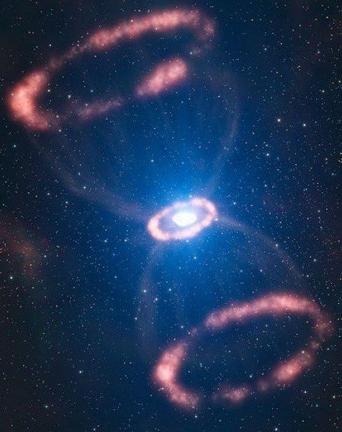
Calibration of Laser Interferometer
Data for Core Collapse Supernovae
Collaborators: B. Ratto, M. Zanolin, Gaberiele Vedovato, J. Kissel, M. Szczepańczyk
Artist Rendition SN 1987A
Notes:
Hello All, thank you all for coming to this lot of presentations, my name is Brad Ratto, I am part of the SN ERAU LIGO group at the Embry Riddle campus, the title of the study I am conducting is Calibration of Laser Interferometer Data for Core Collapse Supernovae.

Slide 2
Overview
Calibration Error for Laser Interferometers
Idiosyncrasies for Core Collapse Supernovae (How & Why is it Different?)
Idiosyncrasies for Gravitational Wave detection algorithms
Impact on the reconstruction of astrophysical parameters
NASA Space Grant 2021
SN 1987A Artist Rendition
Notes:
As eluded to by the title, my study is focused on quantifying the impact of calibration errors from laser interferometer on reconstructed gravitational wave signals, particularly those from CCSN, the emphasis of which will be discussed in later slides. Equally, such a study will then further define its impact on astrophysical parameters which might give way to violations within GR

Slide 3
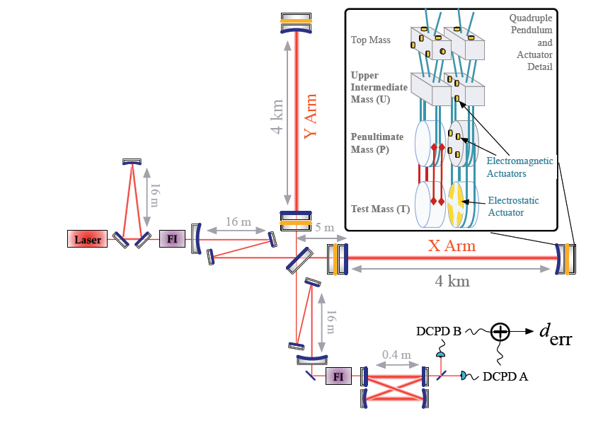
Overview/Flowchart
Optical Intensity $d_{err}$
Calibration Function
Space-Time Strain h(t)
Detection Software
(cWB)
(Ling Sun, 2020)
Notes:
However before we begin our conversation about calibration errors, its useful to see where these calibration errors fit in and where they come from. As many of you are aware, GWs are detected using a interferometer which measures microscopic changes in space-time which then is translated to fluctuations in light intensity at the output port. However in order to back into the information we need, which is GW strain, the light intensity I(t) is convoluted with a calibration filter c(t) in a process known as calibration. This leaves us with the desired strain, h(t) our so call space-time strain as induced by a transient GW.

Slide 4
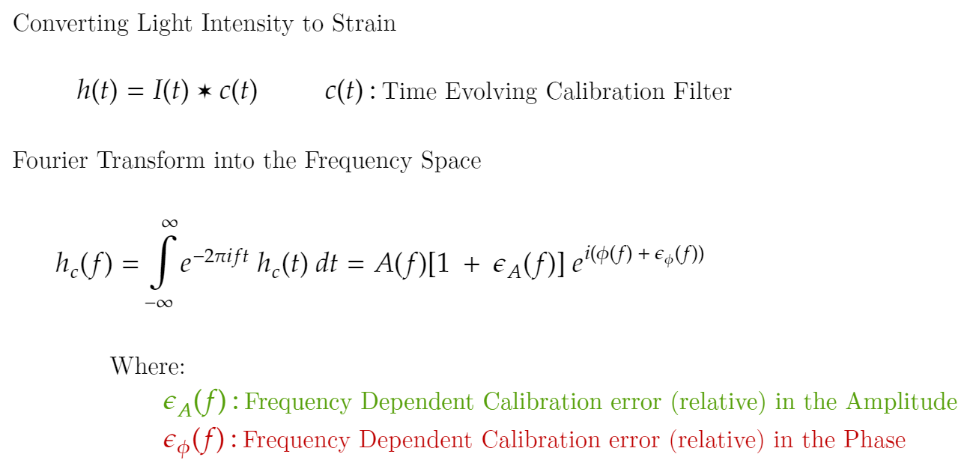
Calibration Errors
$$d_{err}$$
Time Dependent and Evolving Calibration Filter
NASA Space Grant 2021
Notes:
As mentioned in the pervious slide, the process of converting light intensity into strain involves the use of the calibration filter; however uncertainties in this calibration filter leads to inaccuracies and errors in our space-time strain h(t), errors induced by this processes are known as our “calibration errors”. As seen below, these calibration errors effect the measured strain h(f) both in amplitude and phase within the frequency domain which in turn effects h(t) in the time domain.

Slide 5
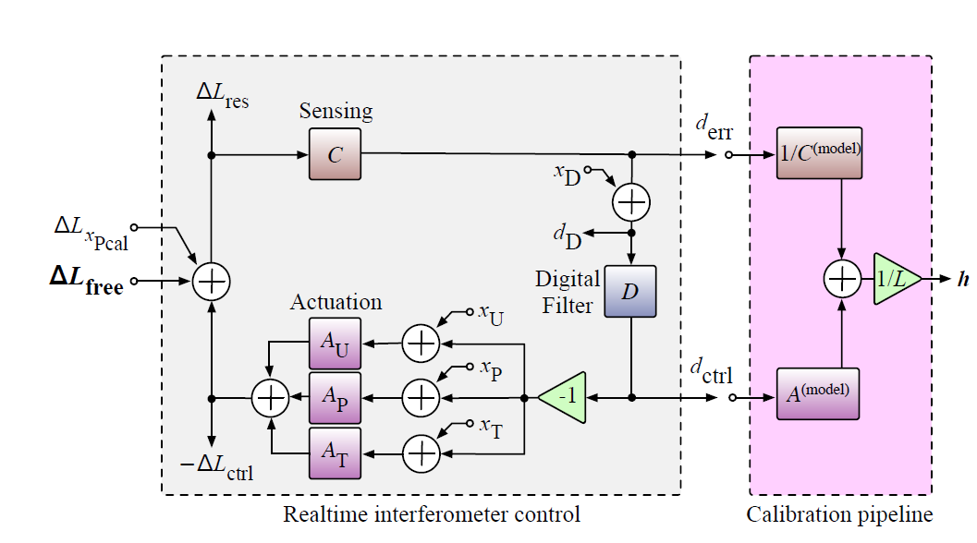
DARM Response/Calibration
(Ling Sun, 2020)
NASA Space Grant 2021
Notes:
But you may ask, what are these “uncertainties ” within the calibration filter and where do they come from? But first, we must ask ourselves where does the calibration filter come from, the figure above represents the DARM control loop, shaded in grey, and the calibration pipeline, shaded in pink. The interferometer can be broken down into various plants, sensing, digital filters, and the suite of actuators; these are the elements that determine the true response of the detector. It is then the necessary model and account for the responses of these individual components to extract our desired h(t); which is the purpose of the calibration pipeline. However, inaccuracies or deviations from these models in the calibration pipeline is what is referred to as our previously mentioned “Calibration Errors”.

Slide 6
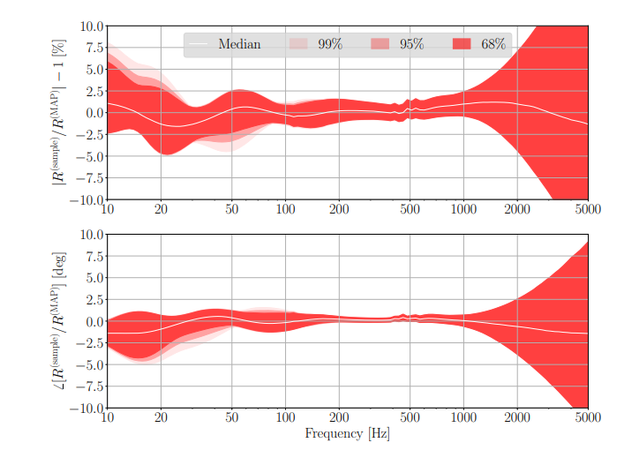
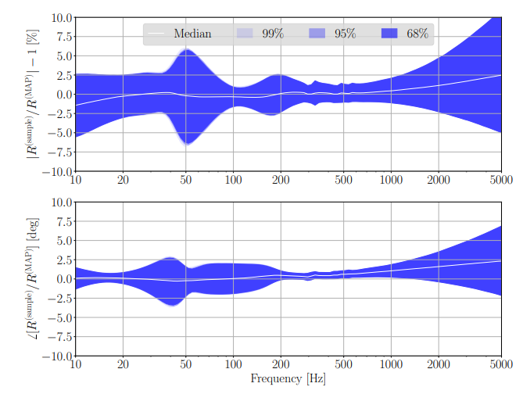
Uncertainty Budget
Hanford, WA
Livingston, LA
(Ling Sun, 2020)
Total Calibration Uncertainty Percentiles for the first epoch in O3A. This shows the frequency dependent departures from unity magnitude and zero phase of the system wrt the model
NASA Space Grant 2021
Notes:
These uncertainties and systematics errors are given to us by the calibration team as uncertainty budgets. Although the maximum amplitude of these errors is documented, the relationship between the phase and amplitude errors of neighboring frequencies is not well under-stood. This project aims to study the impact of this relationship for gravitational waves from core collapse supernovae CCSN.

Slide 7
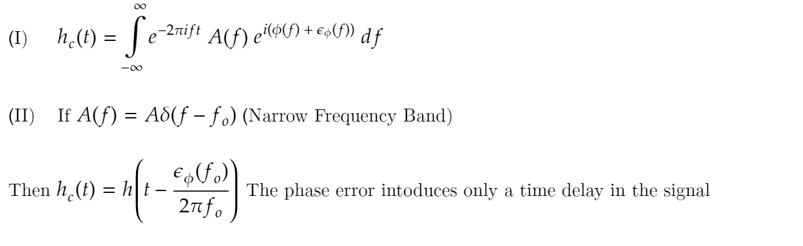
Role of Phase Errors
However, if postulate (II) is not true, a phase shift will cause the morphology of the signal to be altered
NASA Space Grant 2021
Notes:
The topic of calibration errors now shifts to the importance and impact of amplitude and phase errors; in particular, phase errors and their impact on broad band signals such as those from CCSN. Previous studies would model phase shifts as time delays, this is a valid solution if the signal is narrow banded, such as the signals initially detected by LIGO from neutron star mergers. However in the case of signals from CCSN, we see that this condition is not met due to their board band signature. In short, phase errors cause the morphology of a board band signal to be altered. Such effect can be seen in the next slide.

Slide 8
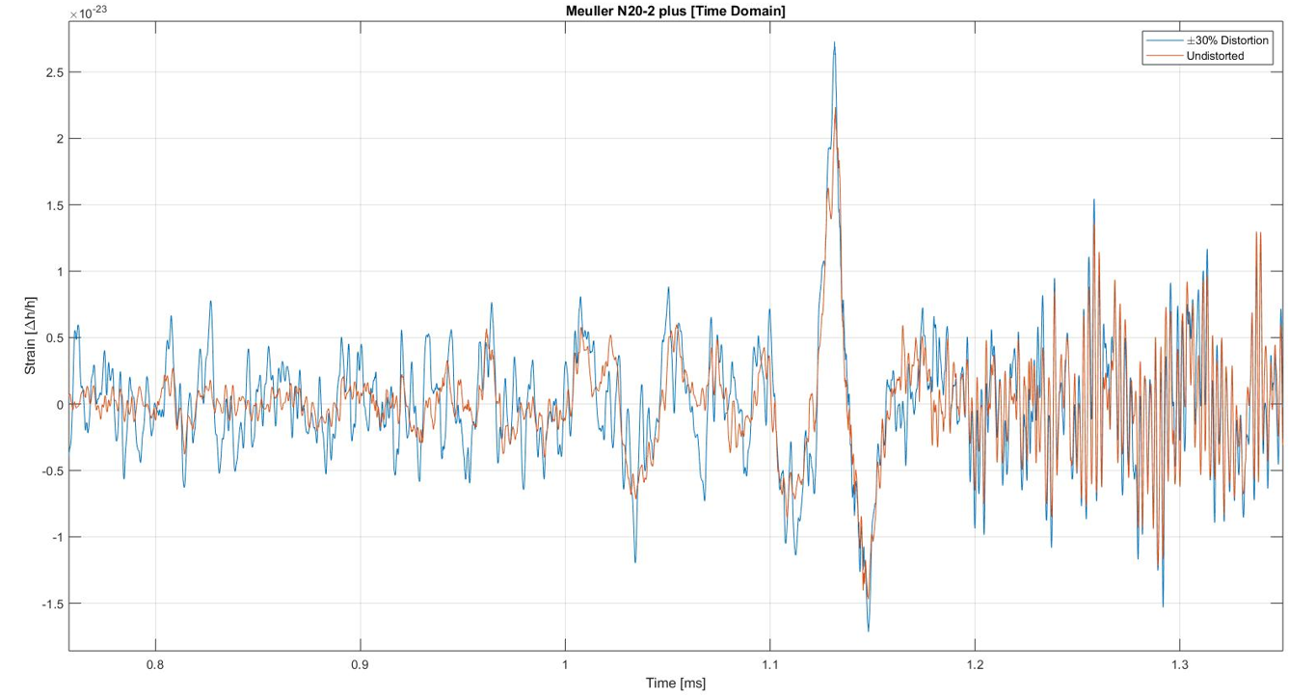
Role of Phase Errors
NASA Space Grant 2021
Notes:
Here we have a sample of a gravitational waveform before and after calibration errors were applied; in orange we see our unaltered waveform and in orange the distorted waveform with a plus or minus randomized amplitude and phase errors within a 30% range. Not only we see the amplitude of the signal being modified but also the shape of the signal being altered as well due to the presence of these phase errors.

Slide 9
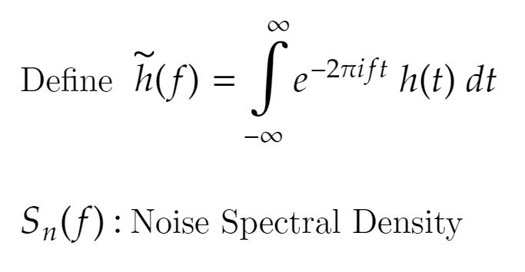
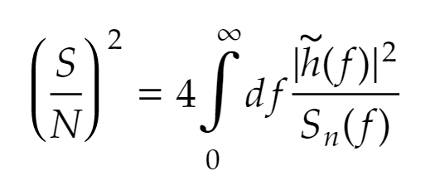
cWB Parameters
The cross-correlation coefficient (cc) lies between -1 and 1.
The effective correlated SNR (rho) is a function of the signal-to-noise ratio (SNR)
NASA Space Grant 2021
Notes:
Parameters such as CC and Rho, however in order to understand their significance and overall impact on a candidate signal, allow me to define them quickly; cross correlation or (CC) for short indicates how similar two reconstructed signals are with each other from the two different detectors. Value of 1 means that the two signals are completely correlated, while a value of -1 means that the series are negatively correlated and finally a value near zero means that the signals can be consider uncorrelated. Our second parameter is Rho, known as effective correlated SNR, in other words, effectively this indicates how “loud” and event was across both detectors.

Slide 10
Preliminary Results
A newly developed cWB plugin allows for frequency and detector dependent calibration errors to be injected into simulated waveforms. Preliminary results from using this plugin can be seen above.
NASA Space Grant 2021
Notes:
Having laid the foundational concepts of the study, I can now share with you all the direction and tools we have developed to conduct such analysis, with the aid of Gab. Ved. a plugin, written in C, has been developed for cWB that allows for frequency and detector dependent calibration errors to be injected into simulated waveforms. In addition to specifying amplitude and phase errors at individual frequencies, the cWB plugin allows for randomized phase and amplitude errors to be selected from either specified ranges, using Gaussian processes or by interpolating between the specified errors at individual frequencies. Results from using the plugin are seen above; the plots show how calibration errors impact parameters of cc and rho for reconstructed signals in contrast with that of unaltered signals.

Slide 11
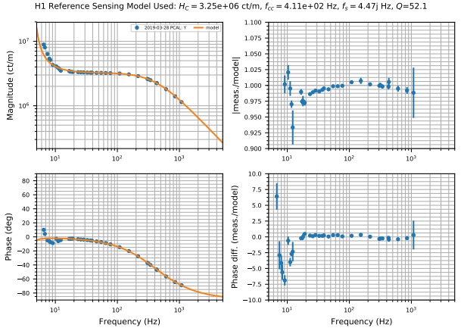
Appropriate Phase/Amplitude Errors
NASA Space Grant 2021

Slide 12
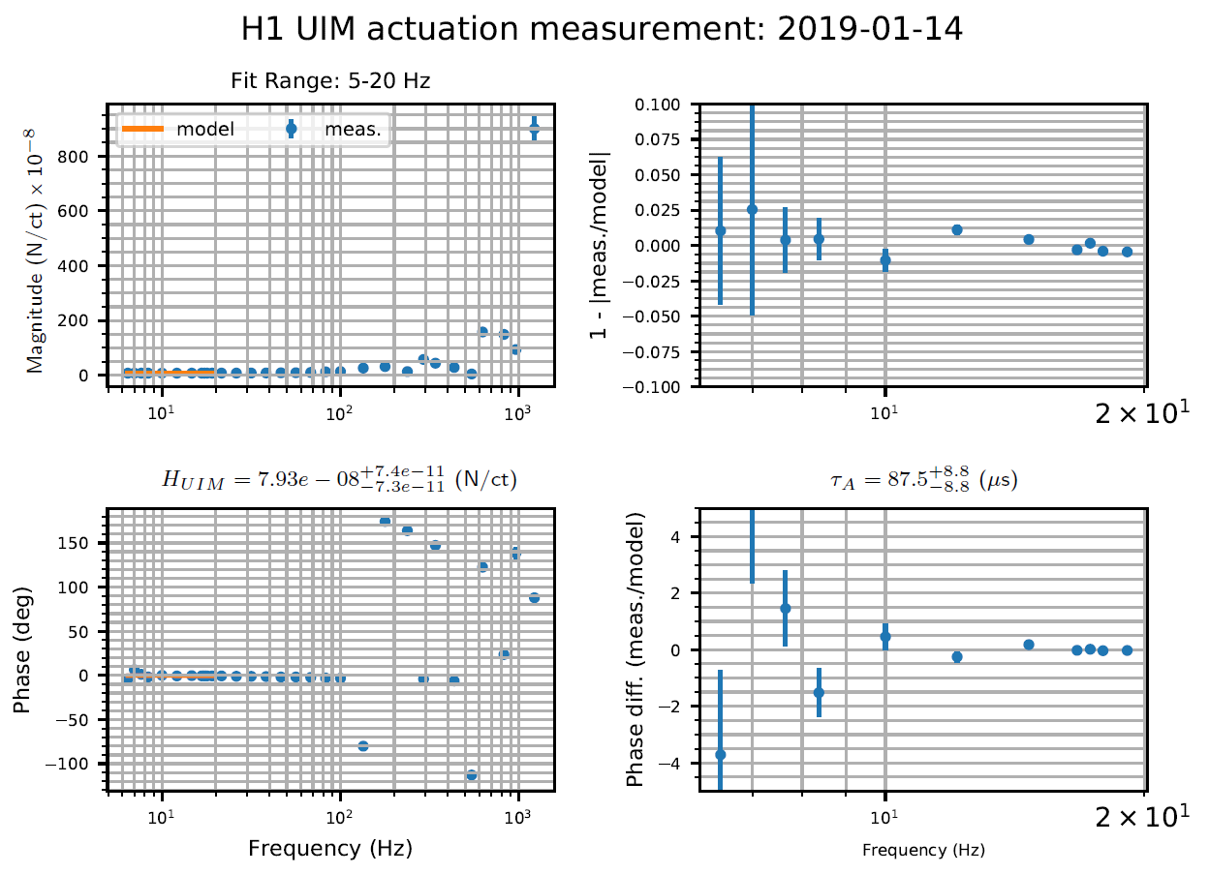
Appropriate Phase/Amplitude Errors
NASA Space Grant 2021

Slide 13
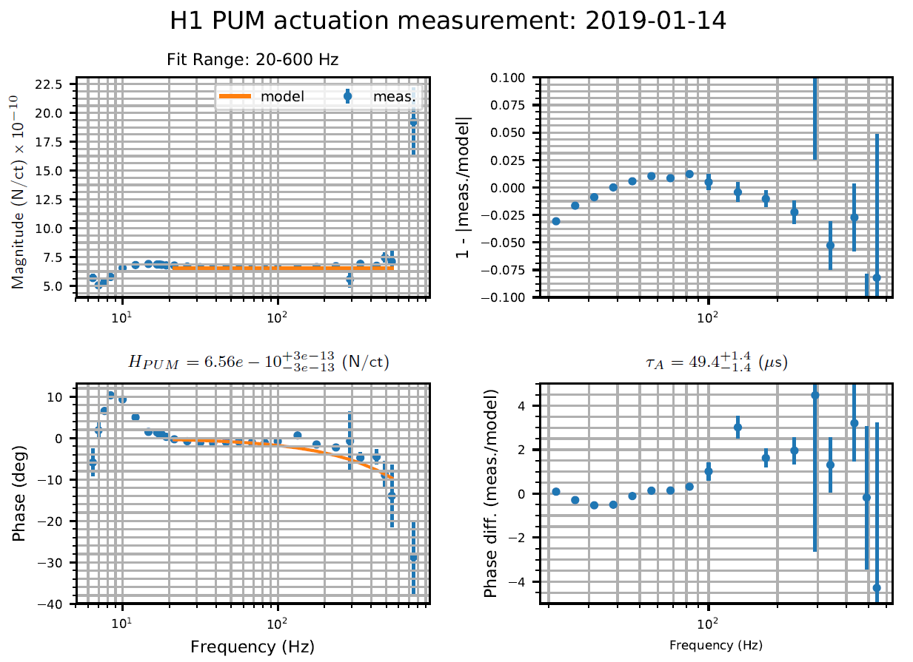
Appropriate Phase/Amplitude Errors
NASA Space Grant 2021

Slide 14
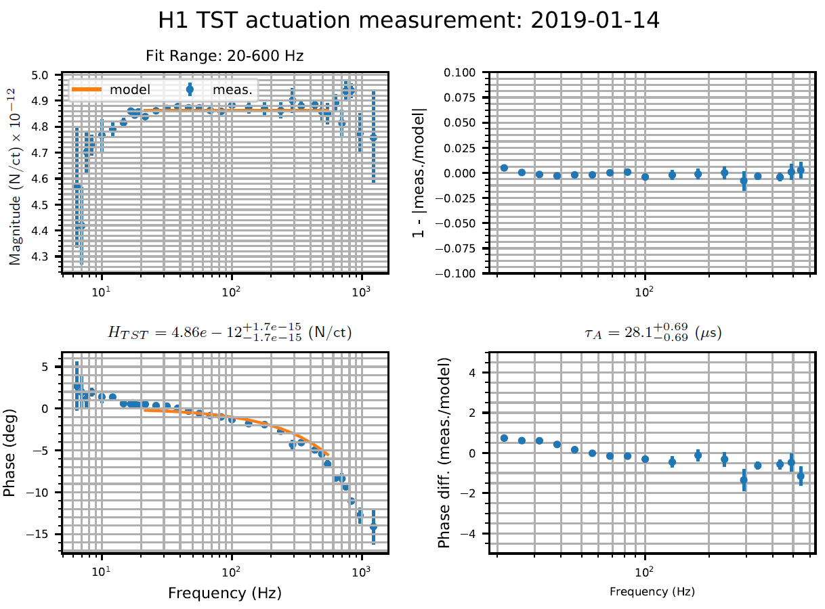
Appropriate Phase/Amplitude Errors
NASA Space Grant 2021

Slide 15
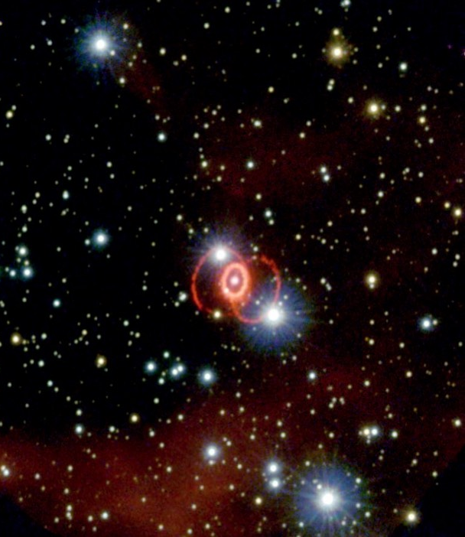
SN 1987A
Next Steps
Identify an appropriate set of realistic phase and calibration errors
Investigate the impact on the reconstruction of astrophysical parameters including possible violations within General Relativity
Questions?
Contact information:
Brad Ratto
rattob@my.erau.edu
Notes:
In conclusion, the primary focus of the study is to identify the relationship between phase and amplitude errors at neighboring frequencies and how they impact the detectability of GWs from CCSN. In this study the plan is to distort GW waveforms according to the O3 calibration errors and inject them into the O3 data using cWB while maintaining a 50% detection efficiency.

Slide 16
Backup Slides

Slide 17
References
B.P. Abbott. (2017). Observation of gravitational waves from a binary neutron star inspiral.
Phys. Rev. Lett., 119:161101
Ling Sun. (2020). Characterization of systematic error in advanced LIGO calibration. Retrieved from https://arxiv.org/abs/2005.02531
Varun Srivastava. (2019). Detection prospects of core-collapse supernovae with supernova-optimized third- generation gravitational-wave detectors. Physical Review D, 100(4)
NASA Space Grant 2021

Slide 18
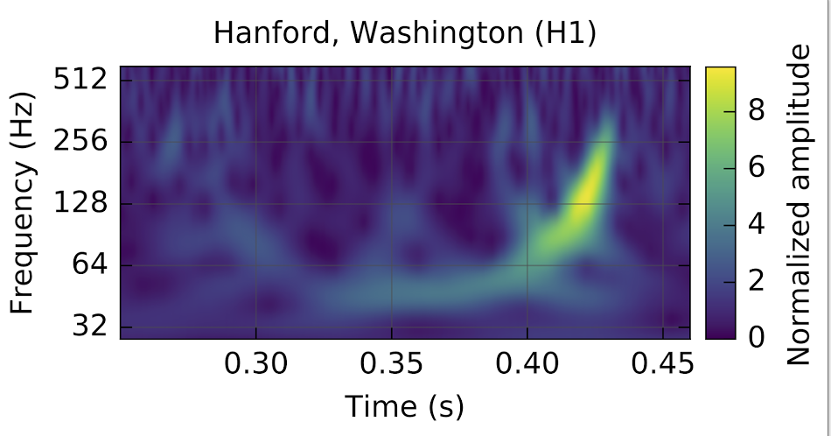
Binary Neutron Star Merger
(B.P. Abbott, 2017)
NASA Space Grant 2021

Slide 19
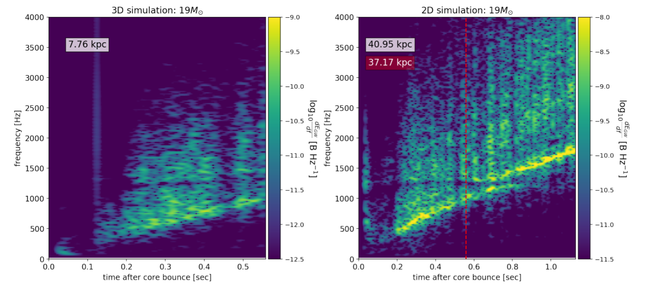
Supernova Simulated Event
(Varun Srivastava, 2019)
NASA Space Grant 2021

Slide 20
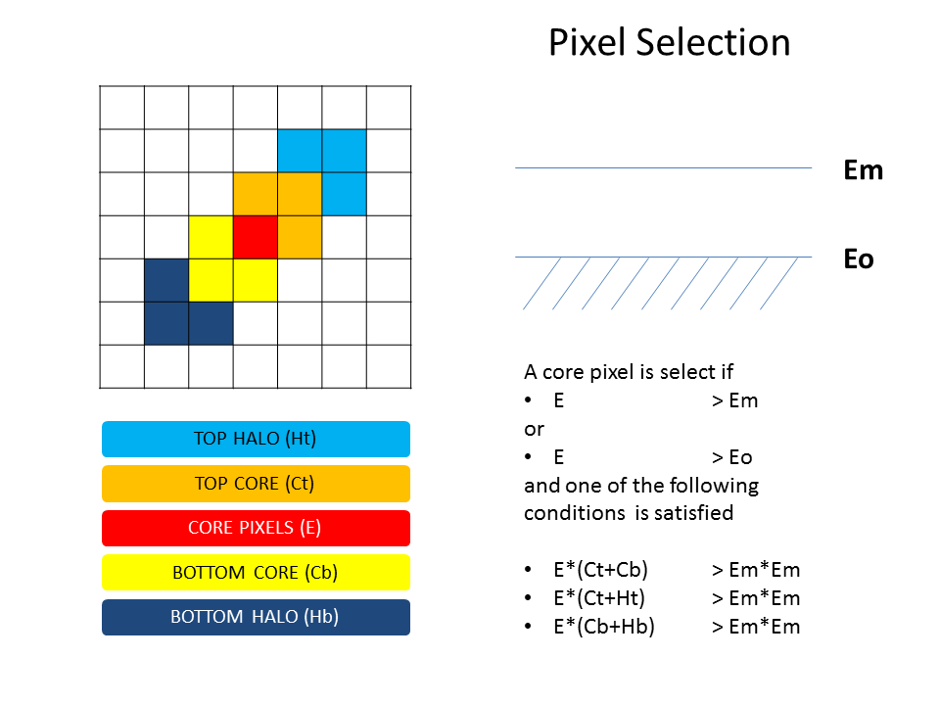
Coherent Wave Burst (cWB)
Process Description:
cWB collects incoming data and constrains it to the maximum likelihood conditions under one coherent statistic.
cWB’s detections are dependent on the total signal to noise (SNR) ratio of the GW signal detected in the network.
NASA Space Grant 2021

Slide 21
Cross Correlation
The cross-correlation coefficient (cc) lies between -1 and 1. Value of 1 means that the two signals are completely correlated, while a value of -1 means that the series are negatively correlated and finally a value near zero means that the signals are consider uncorrelated.
NASA Space Grant 2021

Slide 22
Signal-to-Noise Ratio (SNR)
The signal-to-noise ratio (SNR) indicates how much of the gravitational wave signal is present within a given noise spectral density; ergo a higher SNR indicates a larger probability of a signal being present within a set of data
NASA Space Grant 2021

Slide 23
Fitting Factor
The fitting factor (FF) indicated how well an injected distorted waveform matches the reconstructed waveform cWB produces. The FF is a scalar measure ranging from 0 to 1, such a process takes into account spectral noise density.
NASA Space Grant 2021

Slide 24
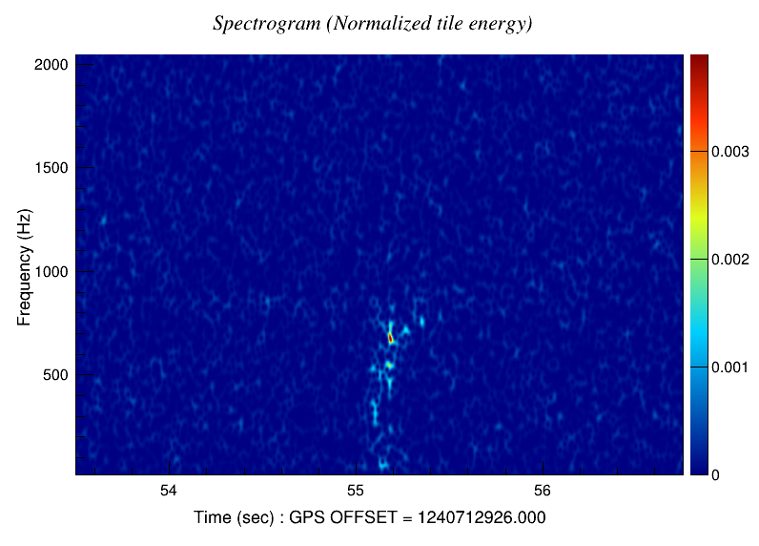
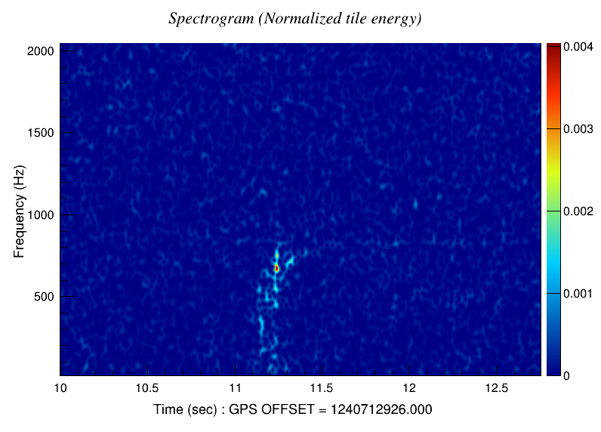
Spectrogram
Undistorted Waveform
10% Amplitude & Phase Error
NASA Space Grant 2021

Slide 25
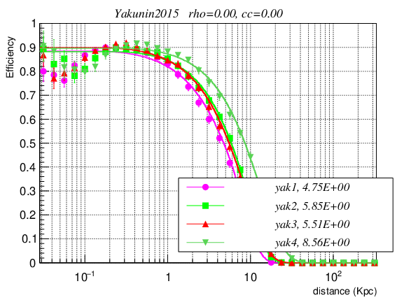
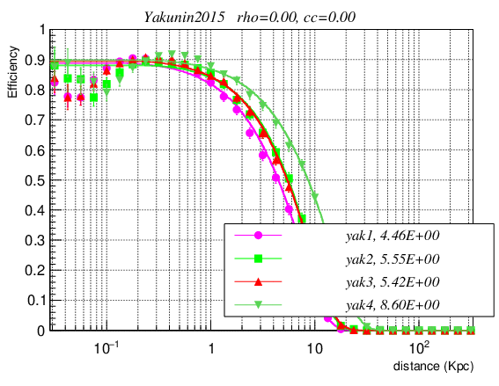
Efficiency vs. Distance
Undistorted Waveform
10% Amplitude & Phase Error
NASA Space Grant 2021

